Slide 1
Detecting CNV by Exome Sequencing
Fah Sathirapongsasuti
Biostatistics, HSPH

Slide 2
Exome Sequencing
Capturing protein coding portion of the genome
~85% of the disease-causing mutations occur in protein coding regions (exome)
Exome constitutes 1% of the genome
About 160,000-180,000 exons
Time-saving and cost-effective

Slide 3
FASTA/FASTQ
SAM/BAM
SAM/BAM
SAM/BAM
SAM/BAM
SAM/BAM
Coverage
VCF/BCF
VCF/BCF
Notes:
Jump to other pages

Slide 9
Pileup
Standard format for mapped data, position summaries
seq1 272 T 24 ,.$.....,,.,.,...,,,.,..^+. <<<+;<<<<<<<<<<<=<;<;7<&
seq1 273 T 23 ,.....,,.,.,...,,,.,..A <<<;<<<<<<<<<3<=<<<;<<+
seq1 274 T 23 ,.$....,,.,.,...,,,.,... 7<7;<;<<<<<<<<<=<;<;<<6
seq1 275 A 23 ,$....,,.,.,...,,,.,...^l. <+;9*<<<<<<<<<=<<:;<<<<
seq1 276 G 22 ...T,,.,.,...,,,.,.... 33;+<<7=7<<7<&<<1;<<6<
seq1 277 T 22 ....,,.,.,.C.,,,.,..G. +7<;<<<<<<<&<=<<:;<<&<
seq1 278 G 23 ....,,.,.,...,,,.,....^k. %38*<<;<7<<7<=<<<;<<<<<
seq1 279 C 23 A..T,,.,.,...,,,.,..... ;75&<<<<<<<<<=<<<9<<:<<
Seq.
Pos.
Len.
Alignment
Quality
Ref.

Slide 11
Variant Call Format
##format=PCFv1
##fileDate=20090805
##source=myImputationProgramV3.1
##reference=1000GenomesPilot-NCBI36
##phasing=partial
#CHROM POS ID REF ALT QUAL FILTER INFO FORMAT NA00001 NA00002
20 14370 rs6054257 G A 29 0 NS=58;DP=258;AF=0.786;DB;H2 GT:GQ:DP:HQ 0|0:48:1:51,51 1|0:48:8:51,51
20 13330 . T A 3 q10 NS=55;DP=202;AF=0.024 GT:GQ:DP:HQ 0|0:49:3:58,50 0|1:3:5:65,3
20 1110696 rs6040355 A G,T 67 0 NS=55;DP=276;AF=0.421,0.579;AA=T;DB GT:GQ:DP:HQ 1|2:21:6:23,27 2|1:2:0:18,2
20 10237 . T . 47 0 NS=57;DP=257;AA=T GT:GQ:DP:HQ 0|0:54:7:56,60 0|0:48:4:51,51
20 123456 microsat1 G D4,IGA 50 0 NS=55;DP=250;AA=G GT:GQ:DP 0/1:35:4 0/2:17:2
##format=PCFv1
##fileDate=20090805
##source=myImputationProgramV3.1
##reference=1000GenomesPilot-NCBI36
##phasing=partial
#CHROM POS ID REF ALT QUAL FILTER INFO 20 14370 rs6054257 G A 29 0 NS=58;DP=258;AF=0.786;DB;H2
FORMAT NA00001 NA00002
GT:GQ:DP:HQ 0|0:48:1:51,51 1|0:48:8:51,51

Slide 13
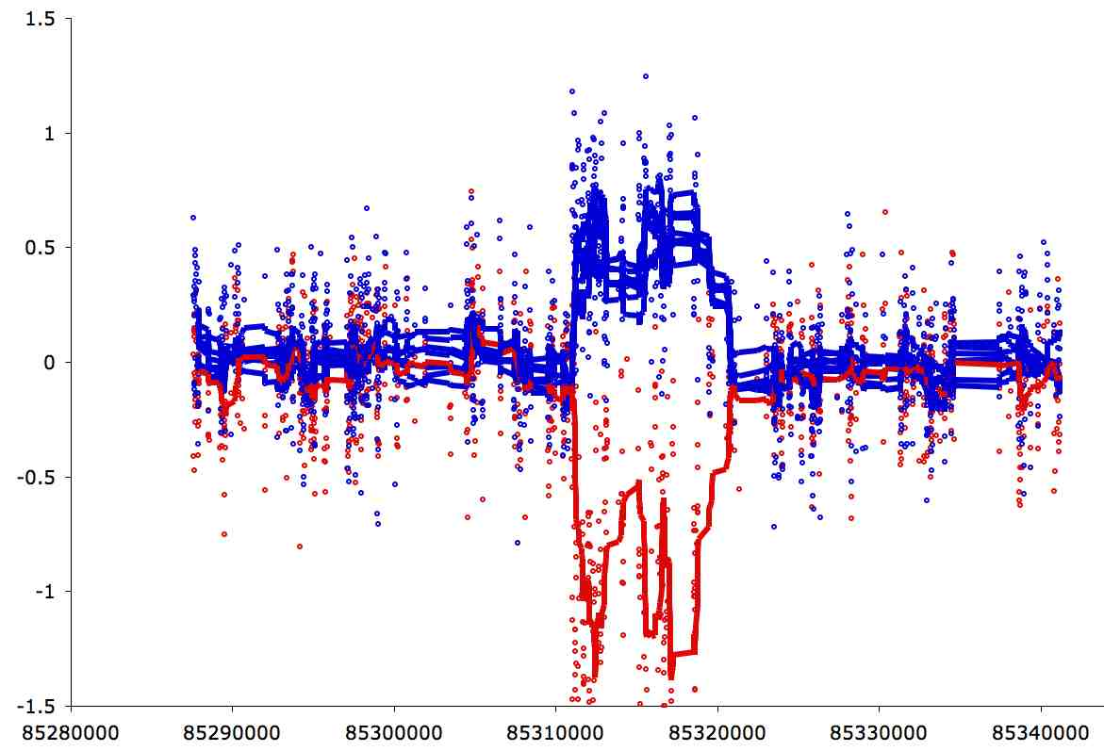
Copy-Number Variation/Alteration
CNV
Comparative Genomic Hybridisation
Blue lines: individuals with two copies.
Red line: individual with zero copy.
gains and losses of chunks of DNA sequences
Sizes:
1kb-5Mb (Sanger’s CNV Project)
Generally large chunks …
Small gains/losses are called insertion/deletion (in-del)

Slide 14
CNV method specific for Exome Seq is needed
All techniques were developed for whole genome sequencing or targeted sequencing of one continuous region.
Two approaches:
Paired-End Methods (use insert size)
Depth of Coverage
Challenges of Exome Sequencing:
Discontinuous search space
Paired-end methods won’t work
The only natural way to discretize the data is by exon
Resolution is limited by distance between exons
Non-uniform distribution of reads
Exon capture probes have different efficiency

Slide 15
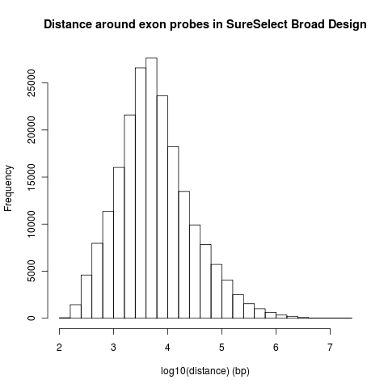
CNV Resolution is limited by exome probe design
Min | 1st Qu | Med | Mean | 3rd Qu | Max
123 | 1,999 | 4,981 | 29,210 | 14,030 | 20,900,000

Slide 16
Depth of Coverage Approach
Treat one exon as a unit (variable length)
Measure depth of coverage (average coverage) per exon
Key assumptions:
Number of reads over exons of certain size follows Poisson distribution
Average coverage is directly proportional to the number of reads; i.e. average coverage = #reads * read length / exon length

Slide 17
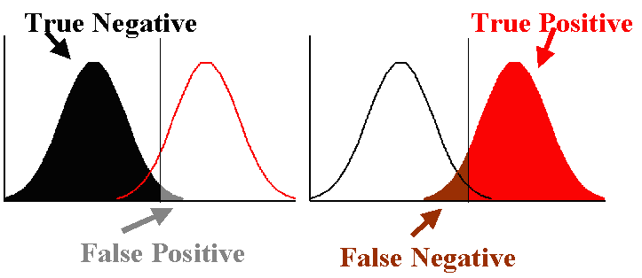
Using the ratio of depth-of-coverage to detect CNV
arbitrary cutoff
Specificity
Sensitivity = Power
Null: no CNV shift Alt: CNV shift

Slide 18
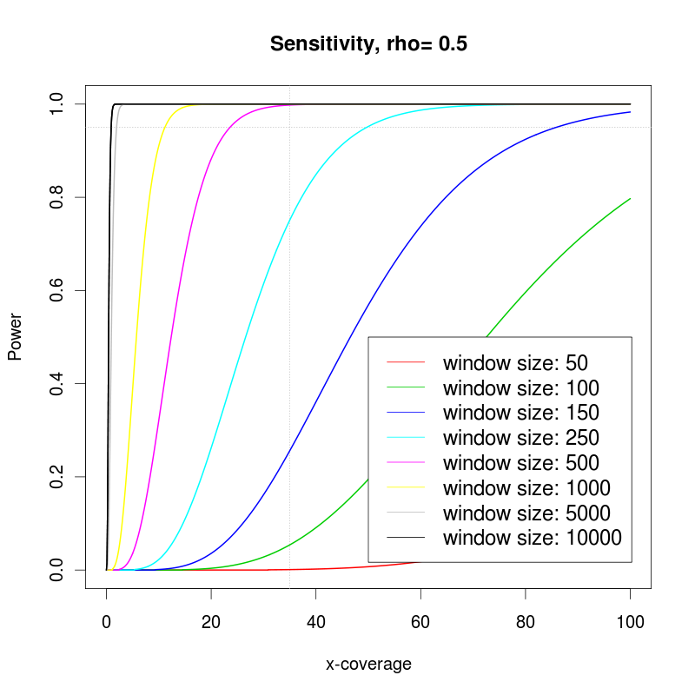
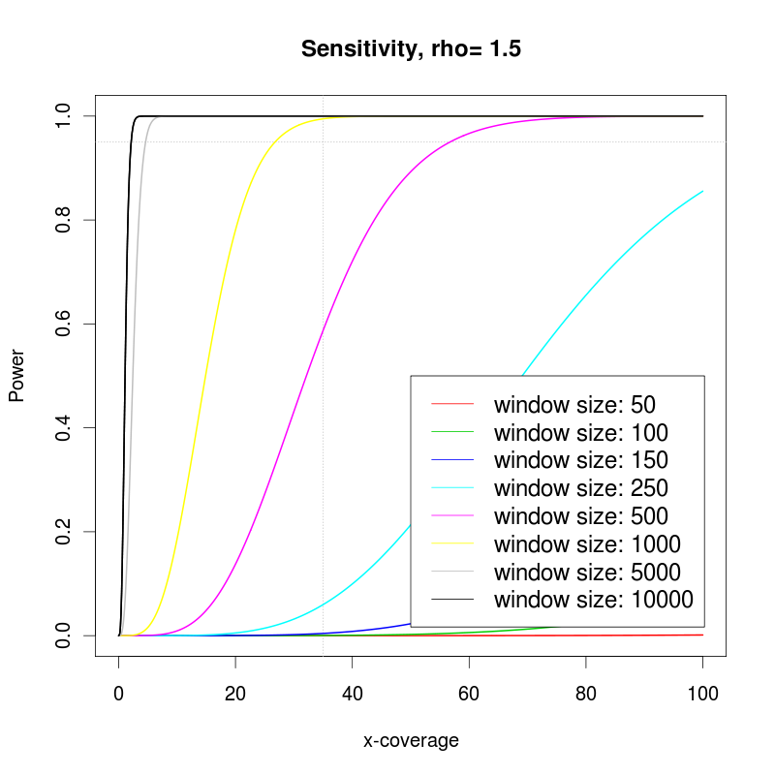
Power to detect CNV depends on depth-of-coverage
Deletion Duplication

Slide 19
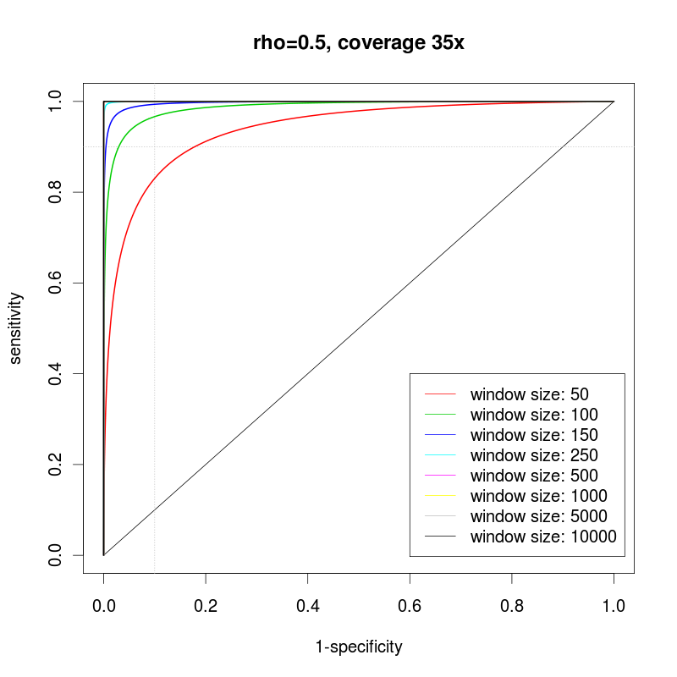
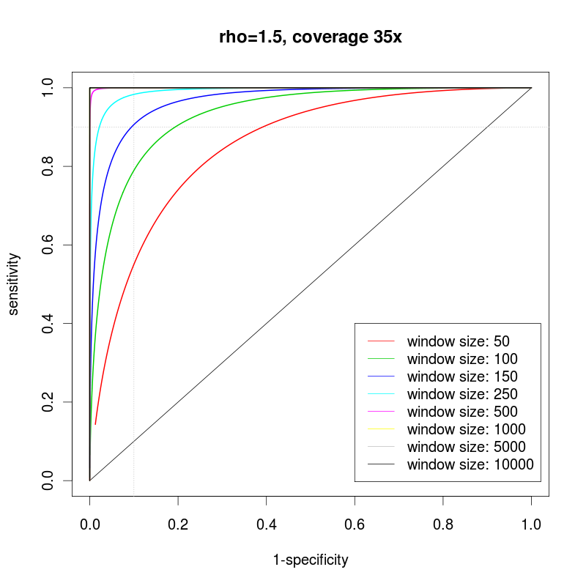
It is generally harder to detect higher copy number as the variance increases linearly with the mean
Deletion Duplication

Slide 20
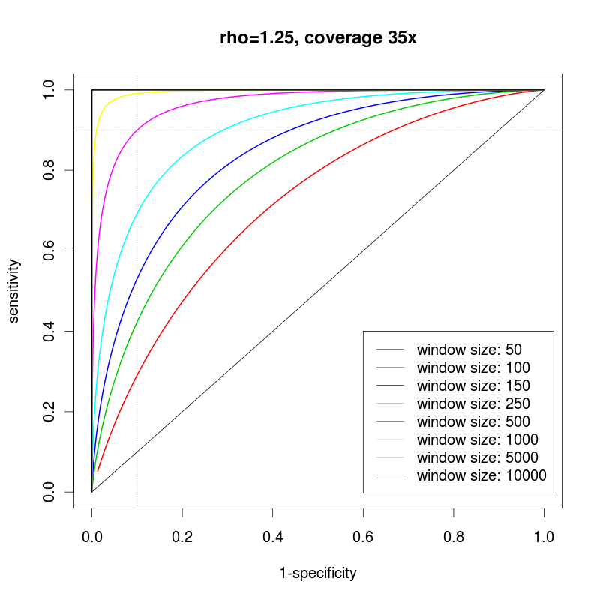
Issue: Admixture
Tumor sample is usually contaminated with normal cells
Ratio will tend to 1, making it more difficult to detect CNV
Have to estimate admixture rate prior to calling CNV otherwise power may be over/underestimated.
50% admixture

Slide 21
ExomeCNV Overview
library(ExomeCNV)
chr.list = c("chr19","chr20","chr21")
suffix = ".coverage"
prefix = "http://genome.ucla.edu/~fah/ExomeCNV/data/normal."
normal = read.all.coverage(prefix, suffix, chr.list, header=T)
prefix = "http://genome.ucla.edu/~fah/ExomeCNV/data/tumor."
tumor = read.all.coverage(prefix, suffix, chr.list, header=T)
source("http://bioconductor.org/biocLite.R")
biocLite("DNAcopy")
install.packages("ExomeCNV")
Notes:
https://secure.genome.ucla.edu/index.php/ExomeCNV_User_Guide

Slide 22
Exome CNV Calling Method
Idea:
Use ROC to determine optimum ratio cutoff for a given exon of certain length and coverage
Only make a call when enough power can be achieved
demo.eCNV = c()
for (i in 1:length(chr.list)) {
idx = (normal$chr == chr.list[i])
ecnv = classify.eCNV(normal=normal[idx,], tumor=tumor[idx,], logR=demo.logR[idx], min.spec=0.9999, min.sens=0.9999, option="spec", c=0.5, l=70)
demo.eCNV = rbind(demo.eCNV, ecnv)
}
do.plot.eCNV(demo.eCNV, lim.quantile=0.99, style="idx", line.plot=F)
demo.logR = calculate.logR(normal, tumor)
Calculate log adjusted ratio
Optimize cutoff based on read coverage, exon length, and estimated admixture rate
Call CNV on each exon

Slide 23
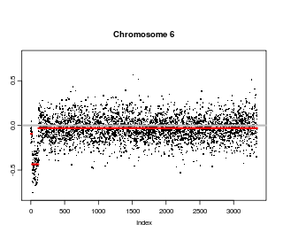
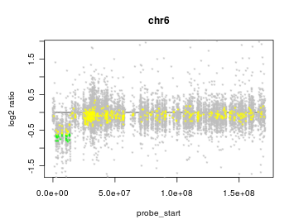
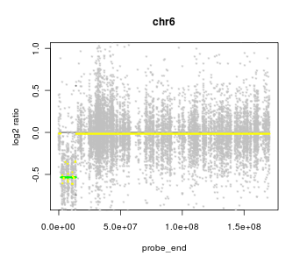
Merging exonic CNVs into segments
Circular binary segmentation

Slide 24
Breakpoint Identification and Sequential Merging
Sequential merging:
Use circular binary segmentation (CBS) algorithm to identify breakpoints, then use the above method to call CNV for segments
Merge exon with no CNV call, normal call, or same CNV call
demo.cnv = multi.CNV.analyze(normal, tumor, logR=demo.logR, all.cnv.ls=list(demo.eCNV), coverage.cutoff=5, min.spec=0.99, min.sens=0.99, option="auc", c=0.5)
do.plot.eCNV(demo.cnv, lim.quantile=0.99, style="bp", bg.cnv=demo.eCNV, line.plot=T)
Call CNV on each exon
Run CBS to merge exons into segments
Call CNV on each segment
Merge with previous CNV segments

Slide 25
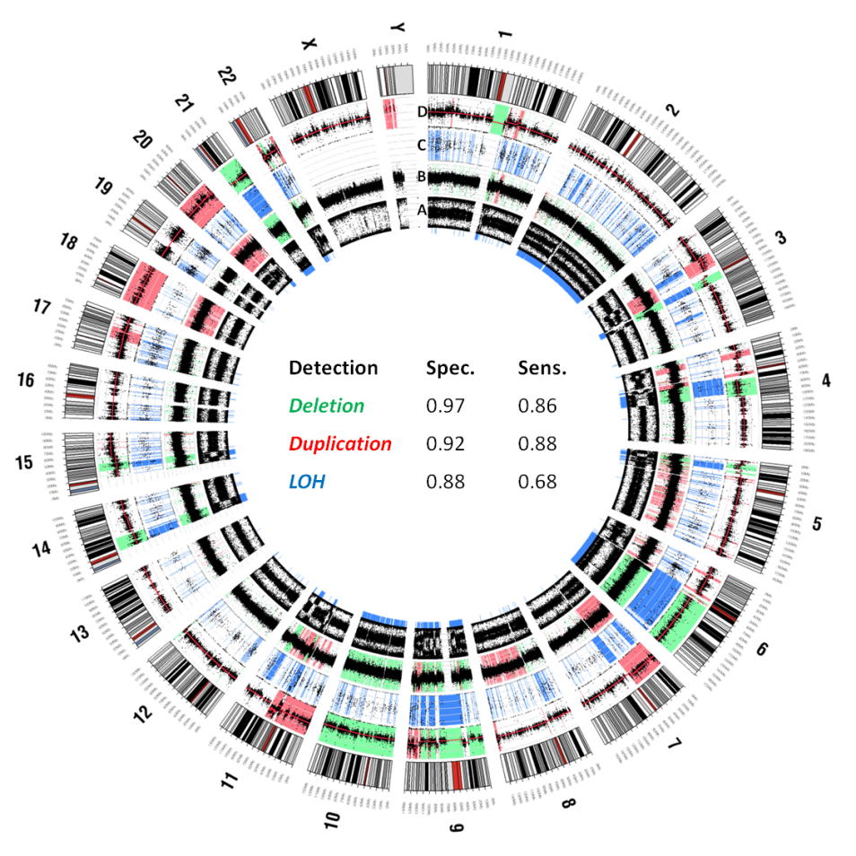
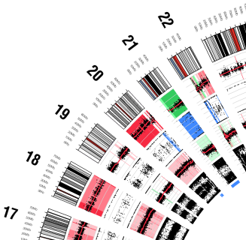
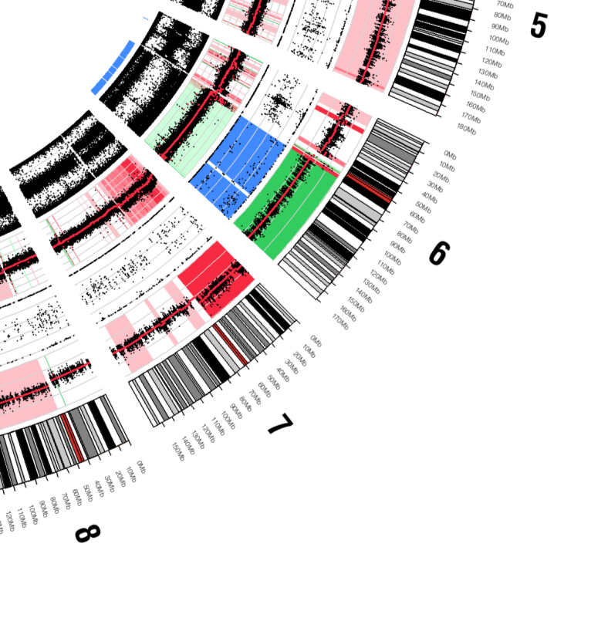
Visualization by circo

Slide 26
Resources
https://secure.genome.ucla.edu/index.php/ExomeCNV_User_Guide
JF Sathirapongsasuti, et al. (2011) Exome Sequencing-Based Copy-Number Variation and Loss of Heterozygosity Detection: ExomeCNV, Bioinformatics, 2011 Oct 1;27(19):2648-54. Epub 2011 Aug 9.

Slide 27
Thank you …

